Slide 1
Major Breaches – Spring 2021 Lesson 12

Slide 2
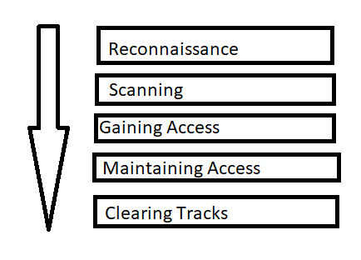
Phases of Hacking

Slide 3
Reconnaissance
The first step, no matter the method of the attack
Learn about the organization
Try to get credentials through social engineering
Enumerate publicly-available systems and services
Identify third-party systems (e.g. SaaS for Payroll, HR, CRM)
Methods
Active Reconnaissance | Passive Reconnaissance
Port Scanning | DNS Searches
SNMP Walking | Information Inquiries
Network Mapping

Slide 4
Active vs Passive Reconnaissance
Advantages/Disadvantages
Active Reconnaissance | Passive Reconnaissance
Advantages: Speed May immediately expose vulnerability | Advantages: Activity is legal Target unaware of activity
Disadvantages: Activity is illegal Target may be aware and take countermeasures | Disadvantages: Slow collection of data Does not provide obvious vulnerability

Slide 5
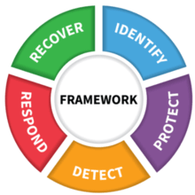
Phases and Risk Management

Slide 6
Phases and Risk Management and Control Objectives
IDENTIFY
PROTECT DETECT
RESPOND
RECOVERY
https://www.youtube.com/watch?v=j0EZpH_eIsY

Slide 7
Cyber Kill Chain
What is it?
The cyber kill chain is a series of steps that trace stages of a cyberattack from the early reconnaissance stages to the exfiltration of data. The kill chain helps us understand and combat ransomware, security breaches, and advanced persistent attacks (APTs)

Slide 8
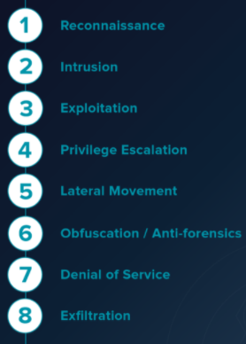
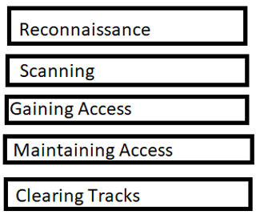
Cyber Kill Chain mapped to Hacking Phases

Slide 9
Breach Definition
A security breach is any incident that results in unauthorized access to computer data, applications, networks or devices. It results in information being accessed without authorization.
A data breach is the intentional or unintentional release of secure or private/confidential information to an untrusted environment.

Slide 10
What is a Breach?
A phishing email was successfully delivered to an employee
A virus made it onto a server and the antimalware software caught it
A bot made it onto a system and has been beaconing with its command and control for a few months
An attacker exploits a cross-site scripting vulnerability in your web application causing problems for people who visit your web site

Slide 11
What is a Breach?
An attacker exploits a cross-site scripting vulnerability in your web application causing problems for people who visit your web site
An attacker sends a phish and the employee succumbs to it and opens a malicious attachment. The attachment has a ransomware and the ransomware completes a large encryption of data in the environment, leaving a note for ransom payment instructions.
An employee takes a thumbdrive full of sensitive data home to do work at home. The thumbdrive is unencrypted. The employee unintentionally leaves it at a restaurant he visited on the way home. Someone picked it up.

Slide 12
Major Breach
Target
Attacker phishes Target’s HVAC supplier
Uses the credentials to get into a supplier portal at Target
Is able to traverse the firewall and be in the internal network at Target
Knows of various methods that Target uses to update servers and exploits a suspected vulnerability
Escalates privileges and traverses network
Places a RAM scraping malware on Target’s POS systems
Moves the credit card data to a server on Target’s network and then slowly pipes out the data to one of many external sites

Slide 13
Major Breach
Target Issues
Supply chain vulnerability
Poor network segmentation
Poor patching
Not responding to alerts

Slide 14
Major Breach
Target
Attacker phishes Target’s HVAC supplier
Uses the credentials to get into a supplier portal at Target
Is able to traverse the firewall and be in the internal network at Target
Knows of various methods that Target uses to update servers and exploits a suspected vulnerability
Escalates privileges and traverses network
Places a RAM scraping malware on Target’s POS systems
Moves the credit card data to a server on Target’s network and then slowly pipes out the data to one of many external sites

Slide 15
Major Breach
Home Depot
Almost precisely the same approach as Target
Supply chain vulnerability
Lack of segmentation
Lack of good encryption
Infected 7500 self-checkout terminals
Was able to grab 56 million credit cards
One of Home Depot’s response was to use EMV Chip and Pin payment methods.
Does this defeat a RAM scraper?

Slide 16
Major Breach
EBay
Social engineering to three internal employees
Directly utilized the employee credentials and got customer info:
145 million Names, Addresses, DOB, and encrypted passwords
Attackers were inside Ebay for at least 230 days before they were discovered

Slide 17
Major Breach
Equifax
Application vulnerability in a website led to a breach
148 million consumers information exposed
Names, addresses, SSN, driver license numbers, birth dates
Attackers were in for 4 months before discovered
Lack of patching a vulnerability allowed a foothold
Lack of segmentation allowed attackers to traverse into the network

Slide 18
Major Breach
Heartland Payment Systems
SQL injection vulnerability in a website led to a breach
Reported by Visa to HPS about suspicious transactions
Attackers were in for 9 months before discovered
HPS lost ability to process payment cards – lost PCI compliance
Had been processing 100 million payments a month for 175,000 clients
Also had to pay $145 million in compensation for fraudulent charges
Lack of patching a vulnerability that was known for years
Lack of segmentation allowed attackers to traverse into the network

Slide 19
Major Breach
Marriott
Breach was actually in place in 2014 with the systems owned by Starwood Hotels
Marriott purchases Starwood and integrates Starwood’s systems in 2016
Breach is identified in 2018
Attackers had four years of access and compromised 500 million records
Credit card numbers of 100 million customers compromised

Slide 20
Major Breach
Yahoo
Social engineering attack
Announced in 2016
Initially, Yahoo said the breach started in 2014
Compromised name, email, addresses, and phone numbers of 500 million users. Passwords were protected.
Later, they found the breach had started in 2013.
Compromised name, email, addresses, phone numbers, passwords and challenge questions of 1 billion users
Then in 2017, Yahoo claimed all 3 billion customers were breached
Verizon was about to buy Yahoo. Price of Yahoo dropped by $350 million because of the breach

Slide 21
Major Breach
SolarWinds
Started with FireEye announcing a breach of its major security tool
Investigation led to discovery of breach of SolarWinds
Hackers able to infiltrate the software development and deployment process of SolarWinds
Put malware in a SolarWinds update package and got it published
That malware went out to 18000 SolarWinds customers
Malware activated to look at systems that SolarWinds manages/monitors and extract data

Slide 22
Major Breaches
The major points
The prevalence of social engineering as an attack approach
The number of times that the breach came from the supplier vector
How long attackers are in the environment before discovery
The impact of such breaches in terms of cost and customer inconvenience/harm

Slide 23
Threat to Vulnerability Mapping
THREAT: DDOS
VULNERABILITY:
UNAWARE USERS
MISCONFIGURED SYSTEM EMPLOYEE BACKGROUND CHECK ERRORS

Slide 24
Threat to Vulnerability Mapping
THREAT: MALWARE
VULNERABILITY:
MISCONFIGURED SYSTEM
PHYSICAL HAZARDS
IMPROPER DISPOSAL OF MEDIA

Slide 25
Threat to Vulnerability Mapping
THREAT: BLACK HAT
VULNERABILITY:
CROSS SITE SCRIPTING
POOR CABLE SECURITY
INADEQUATE VETTING OF SUPPLIERS

Slide 26
Threat to Vulnerability Mapping
THREAT: INSIDER
VULNERABILITY:
INADEQUATE PASSWORD MANAGEMENT
LACK OF ENCRYPTION UNCONTROLLED USE OF INFORMATION SYSTEMS
UNMOTIVATED EMPLOYEES

Slide 27
Threat to Vulnerability Mapping
THREAT: ACTIVE RECONNAISSANCE
VULNERABILITY:
INADEQUATE NETWORK SEGMENTATION
INADEQUATE SEGREGATION OF DUTIES
INSECURE CODING PRACTICES

Slide 28
Lesson 12 Concepts
The prevalence of social engineering as an attack approach
The number of times that the breach came from the supplier vector
How long attackers are in the environment before discovery
The impact of such breaches in terms of cost and customer inconvenience/harm
Threats to vulnerabilities mapping

